Slide 1

Internal Controls & GASB Update
Ozarks AGA – March 26, 2026

Slide 2

Meet the Presenter
Evan Masters
Lead Consultant / Grants Management Services

Slide 3
Learning Objectives
Internal Controls Overview
Greenbook Control Components
Internal Controls – AI Practical Considerations
GASB Updates

Slide 4

Internal Controls
  Objectives & Considerations

Slide 5
Goals of Internal Controls
Efficient & effective operations
Reporting that is reliable both internally & externally
Compliance with applicable laws & regulations

Slide 6
Importance of Internal Controls
Safeguard assets
Protect employees
Provide more accurate financial statements
Compliance with laws & regulations
Reduce risk of de-obligation of federal funds
Reduces risk of fraud, waste, & abuse

Slide 7
Fraud, Waste, & Abuse
Fraud – Attempt to obtain something of value through willful misrepresentation
  Example: Underreporting income to receive federal subsidies
Waste – Squandering money & resources, even if not explicitly illegal
  Example: Excessive prices for government purchase (like $500 screwdrivers)
Abuse – Behaving improperly or unreasonable or misusing one’s position or authority
  Example: Requesting staff to perform personal errands or work tasks for a supervisor or manager

Slide 8
Deterring Fraud, Waste, & Abuse
Organizations cannot eliminate all risks of fraud, waste, & abuse, but the risk can be reduced in a strong internal control environment
Internal controls:
  Prevent fraud, waste, & abuse
  Detect when fraud, waste, & abuse occur
  Mitigate the impacts of fraud, waste, & abuse

Slide 9
Internal Control Standards
COSO Framework – Designed by the Committee of Sponsoring Organizations of the Treadway Commission (COSO)
  Standards are used primarily by publicly traded companies but can be used by any size organization
  Broadly applicable to different industries
Greenbook – Designed by the Government Accountability Office (GAO)
  Standards designed for federal agencies
  Can be adopted by state, local, & nonprofit entities
  Adapts principles of COSO for a government context

Slide 10
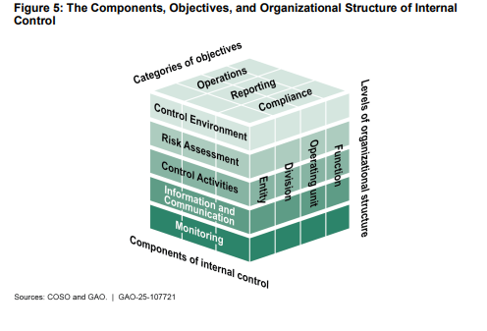
Greenbook
Control Components

Slide 11
Control Environment
Foundation for an internal control system, provides discipline & structure to help an entity achieve its objective
Principles
  Demonstrate commitment to integrity & ethical values
  Independent board of directors’ oversight
  Establish structure, reporting lines, responsibility, & delegate authority
  Recruit, develop, & retain competent individuals
  Evaluate performance & hold individuals accountable

Slide 12
Risk Assessment
Assesses internal & external risk to provide the basis for developing appropriate responses
Principles
  Clearly define objectives & define risk tolerance
  Identify, analyze, & respond to risks related to achievement of objectives
  Consider the potential for fraud, improper payments, & information security when identifying & responding to risk
  Identify & assess significant changes that impact the system

Slide 13
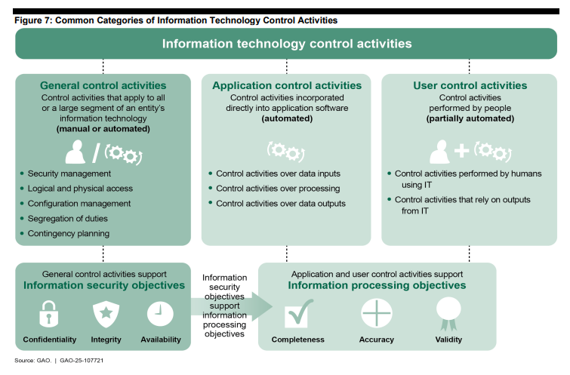
Control Activities
Actions established through policies & procedures to mitigate risk & achieve objectives
Principles
  Design control activities to achieve objectives
  Design general control activities over information technology
  Implement control activities though policies & procedures
Link to Green Book Graphic

Slide 14
Information & Communication
Effective information & communication are vital for an entity to achieve its internal control objectives
Components & Principles
  Obtain or generate relevant, quality information to support the internal control system
  Internally communicate the necessary information
  Externally communicate matters impacting the functioning of the internal control system

Slide 15
Monitoring Activities
Monitoring assesses the quality of performance over time & promptly resolves audit findings
Components & Principles
  Establish & operate monitoring activities to monitor the system
  Remediate identified internal control deficiencies on a timely basis

Slide 16
Implementation of Internal Controls
Identify goals for operations, reporting, & compliance
Establish a healthy control environment (organizational values)
Identify any risks that could prohibit you from reaching your goals
Design control activities in the form of policies & procedures
Communicate effectively throughout the organization
Monitor on an ongoing basis & refine according to your findings

Slide 17
Internal Controls & Artificial Intelligence
Practical Considerations
Control Environment
Risk Assessment
Integrity & Ethical Values – Adopt a clear AI Acceptable Use Policy to govern AI usage within the organization
Oversight – Make sure that governing boards & oversight committees have knowledge of AI usage & associated risks
Responsibility – Delegate ownership of each AI system created to someone who can be responsible for its outcomes
Training – Provide training to staff & leadership regarding acceptable uses for AI
Evaluate Performance – Design performance standards & clearly define consequences for improper use.
Define Objectives – Consider & define specific objectives for each area where AI is used. Think about the intended users & regulatory or legal requirements.
Identify Risk – Consider risk for current AI adoption & anticipate future risks related to technology developments & platform updates.
Fraud Risk – Consider how both internal & external AI usage may increase the likelihood of fraud.
Identify Significant Changes – Risk assessments should track changes in the AI & regulatory environment

Slide 18
Internal Controls & Artificial Intelligence
Practical Considerations
Control Activities
Information & Communication
Design Control Activities – Consider including human professional judgment within AI generated activities to prevent errors.
Information Technology – Consider how AI assets may be subject to existing IT controls such as access restrictions & approvals.
Policies & Procedures – If AI is now impacting an existing policy or procedure, update policies & procedures accordingly. Consider, do policies & procedures need to be updated more frequently due to pace of AI adoption?
Quality Information – For processes involving AI, consider how you will document the work performed. Can you access the backend to determine if processes were performed correctly?
Internal Communication – Establish internal communication protocols & clearly define roles & boundaries for the AI tool’s usage.
External Communication – Consider notifications to external stakeholders when content is generated by AI.
Monitoring Activities
Monitor the System – Perform regular checks to confirm that AI tools are operating as intended. Perform separate “stress tests” with abnormal situations to test the system.
Remediate Deficiencies – When deficiencies are identified in AI systems notify the appropriate stakeholders & take steps to correct.

Slide 19
GASB Updates

Slide 20

GASB 103
Financial Reporting Model Improvements
Effective Date
Fiscal years beginning after June 15, 2025

Slide 21
Scope & Applicability
MD&A
Unusual or Infrequent Items
Proprietary Fund Statement of Revenues, Expenses, & Changes in Net Position
Major Component Unit Information
Budgetary Comparison Information
Financial Trends in Statistical Section

Slide 22
Management’s Discussion & Analysis
01

Slide 23
Management’s Discussion & Analysis
MD&A
Still RSI & in front of basic statements
Focus
Primary government
Inclusion of DPCU up to professional judgment
Compare current year to prior year, with emphasis on current year
Analysis should explain WHY balances & results of operations have changed from prior year
Avoid:
“Boilerplate” language & discussions
Based on nature & significance of relationship to primary government
Unnecessary duplication

Slide 24
Financial Reporting Model Improvements – MD&A
Detailed Analysis
Analysis of balances & transactions of each major fund in the aggregate
  Reasons for changes in both governmental & business-type activities
  Discuss currently known facts, decisions, or conditions of which users of the financial statements may not be aware
  Discuss any significant policy changes & important economic factors affecting operating results

Slide 25
Financial Reporting Model Improvements – MD&A
Significant Capital Asset & Long-Term Debt Activity
Capital asset activity (including right-to-use & other intangible assets)
  Discuss significant additions, disposals, & changes to commitments to acquire capital assets, & any relevant factors
Long-term debt activity (including leases, PPPs, SBITAs)
  Discuss agreements entered into, credit rating changes, any debt limit changes that may affect financing of planned facilities or services, & any relevant factors

Slide 26
Financial Reporting Model Improvements – MD&A
Currently Known Facts, Decision, or Conditions
Economic or demographic trends
Subsequent year’s budget
  Changes in amount available for appropriation
  Changes in planned spending (inflation, labor contracts, new laws, & regulations, etc.)
  Expected changes in fund balance/net position
Actions taken by government after year-end regarding postemployment benefits, capital assets, long-term debt, leases, PPPs, & SBITAs
Actions taken by others after year-end (new laws/regulations)

Slide 27
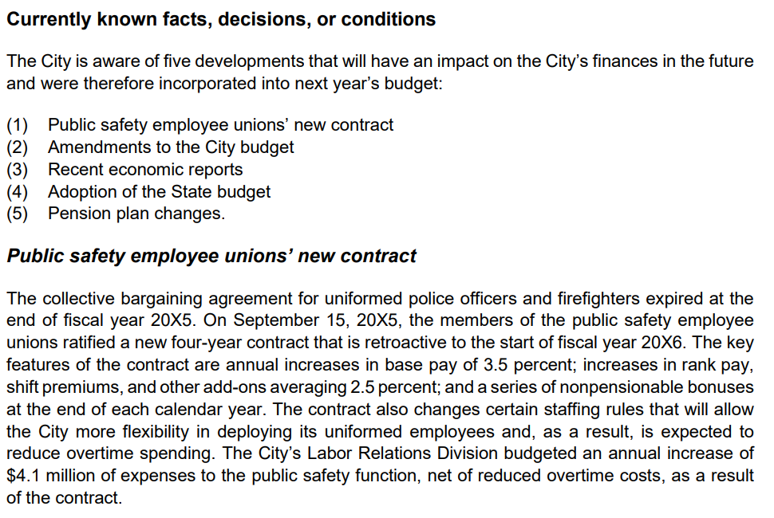
Financial Reporting Model Improvements – MD&A
Currently Known Facts, Decision, or Conditions – Example
GASB 103
Appendix C
Exhibit 1

Slide 28
Unusual or Infrequent Items
02

Slide 29
Unusual or Infrequent Items
Extraordinary or special items
Unusual or infrequent items

Slide 30
Unusual or Infrequent Items
Unusual Nature
High degree of abnormality
Infrequency of Occurrence
Not reasonably expected to recur in the future
Use the government’s past experience to provide evidence of the future
Clearly or incidentally related to activities

Slide 31
Unusual or Infrequent Items
Present inflows/outflows as last item on flows statements/statement of activities, above net change in fund balance/net position
  Present each item separately
  Do not net
Disclose program, function, or activity to which item relates & whether in control of management

Slide 32
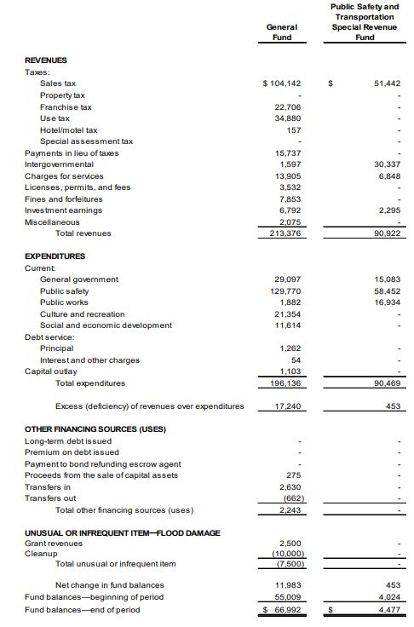
Unusual or Infrequent Items
Example
GASB 103, Appendix C, Exhibit 5

Slide 33
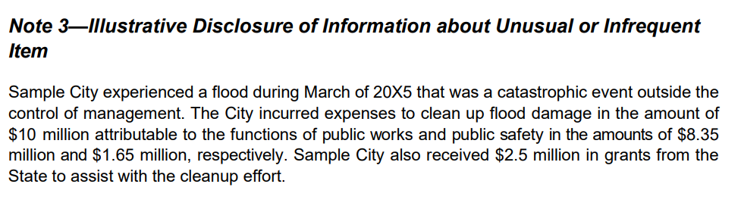
Unusual or Infrequent Items Example
GASB 103, Appendix C, Exhibit 14

Slide 34
Proprietary Funds
03

Slide 35
Proprietary Funds
Statements should distinguish between operating & nonoperating revenues & expenses.
Nonoperating revenues & expenses includes:
  Subsidies received & provided
  Contributions to permanent & term endowments
  Revenues & expenses related to financing
  Resources from disposal of capital assets & inventory
  Investment income & expenses
Operating is revenue & expenses that is other than above

Slide 36
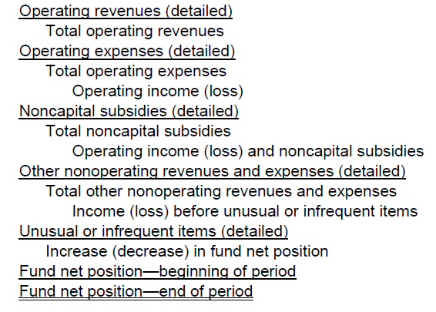
Proprietary Funds
Presentation
Must be presented in order shown
New subtotals for noncapital subsidies & unusual or infrequent items
Only present those captions that are applicable

Slide 37
Proprietary Funds
Subsidies Definition
Resources received for which
  goods & services are not provided &
  that directly or indirectly keep the proprietary fund’s current or future fees & charges lower than they would be otherwise
Resources provided for which
  goods & services are not received &
  recoverable through proprietary fund’s current or future pricing policies
All other transfers
Notes:
GASB literature did not previously define the term subsidies.
All other transfers includes interfund transfers

Slide 38
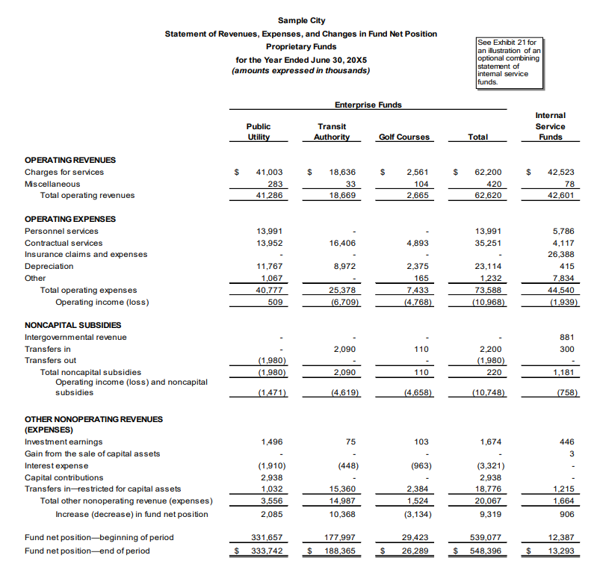
Proprietary Funds
Subsidies Example
GASB 103, Appendix C, Exhibit 8
Notes:
GASB concluded that a subtotal including noncapital subsidies is necessary because it provides a clearer understanding of the financial performance of property funds/entities that receive regular subsidies & a more accurate performance measure than the current operating income (loss) subtotal, which primary indicates whether the fund/entity is self-supporting or subsidized.

Slide 39
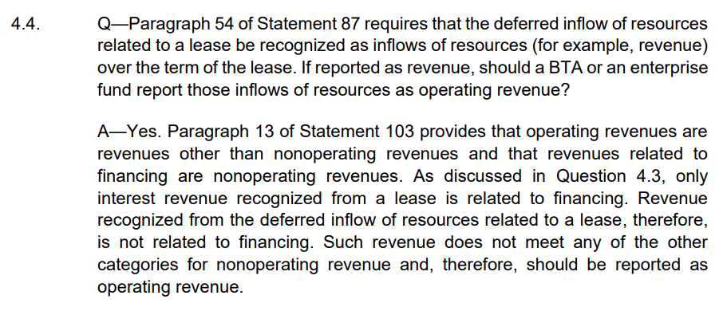
Implementation Guide 2025-1 Question 4.4
Deferred Inflows of Resources Related to a Lease

Slide 40
Major Component Units
04

Slide 41
Major Component Units
Present each separately in statement of net position & statement of activities
  Unless it reduces readability of statements
If reduces readability, include combining statements after fund financial statements
No change to major component unit criteria

Slide 42
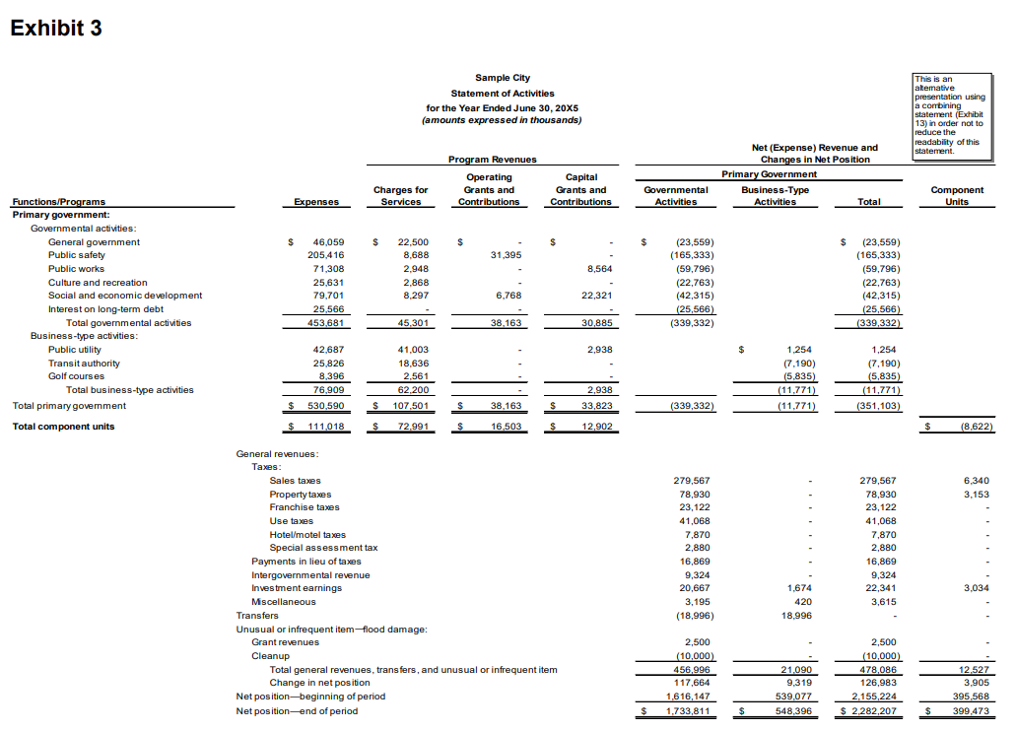
Major Component Units
Example
GASB 103, Appendix C, Exhibit 3

Slide 43
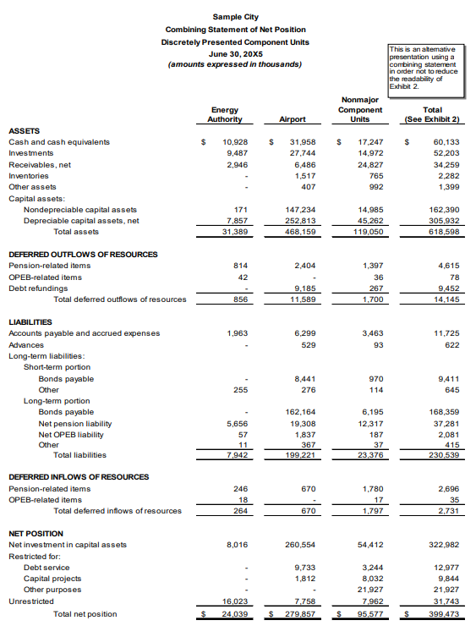
Major Component Units
Example
GASB 103, Appendix C, Exhibit 13

Slide 44
Budgetary Comparison Information
05

Slide 45
Budgetary Comparison Information
Must present exclusively as RSI
Variance between original & final budget amounts
Variances between final budget & actual amounts
Explanation of significant variances in the notes to the RSI

Slide 46
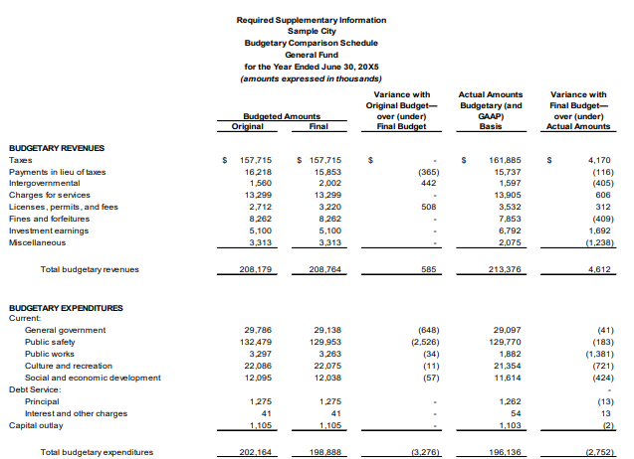
Budgetary Comparison Information
Example
GASB 103, Appendix C, Exhibit 15

Slide 47
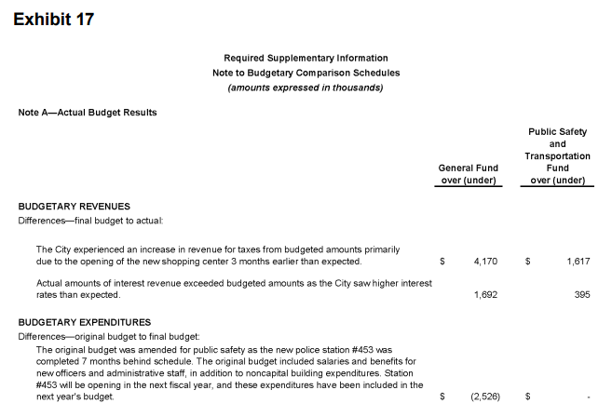
Budgetary Comparison Information
Example
GASB 103, Appendix C, Exhibit 17

Slide 48
GASB 104
Disclosure of Certain Capital Assets
Effective Date
Fiscal years beginning after June 15, 2025

Slide 49



Statement 104 does not change any current recognition or measurement requirements.
Capital Assets
Leases
Subscription Assets

Slide 50
What Does Change With GASB 104?
For the capital assets notes disclosure required by Statement 34, the following items should be broken out separately:
  Lease assets (Statement 87) by major class of underlying assets
  Intangible RTU recognized by an operator (Statement 94) by major class of underlying public-private & public-public partnership asset
  Subscription assets (Statement 96)
  Other intangible assets by major class of asset
Intangible assets that represent the right to use intangible underlying assets are not required to be disclosed separately but should not be reported with owned intangible assets

Slide 51
GASB Projects

Slide 52
Projects
Project Name | Next Milestone | Expected Date
Going Concern Uncertainties & Severe Financial Stress The objective of this project is to address issues related to disclosures regarding going concern uncertainties & severe financial stress | Exposure Draft | 2Q 2026
Infrastructure Assets This project will address issues related to accounting & financial reporting for infrastructure assets. | Exposure Draft | 1Q 2026

Slide 53
Projects
Project Name | Next Milestone | Expected Date
Implementation Guidance Update – 2026 The objective of this project is to update implementation guidance for additional issues that came to the attention of the staff. The 2026 update project is focused solely on issues related to subsidies as defined in Statement No. 103, Financial Reporting Model Improvements. | Public Comment Period | Open Now – 4/27/26
Revenue & Expense Recognition The objective of this project is to develop a comprehensive, principles-based model that would establish categorization, recognition, & measurement guidance applicable to a wide range of revenue & expense transactions. | Exposure Draft | 1Q 2027

Slide 54
Pre-Agenda Research
Project Name | Description
Cybersecurity Risk Disclosures | Understand the types of threats faced by state & local governments & how they are disclosed.
GAAP Structure | Evaluate the effectiveness of the GASB’s current dual-authority approach to communicating generally accepted accounting principles (GAAP) for state & local governments.
Pension & OPEB Disclosures – Concepts Statement 7 | Evaluate the required disclosures in Statements No. 67, 68, 74, & 75 as it relates to Concepts Statement No. 7.
Revenue & Expense Recognition – Note Disclosures | Research any required note disclosures related to the revenue & expense recognition project.

Slide 55


Slide 56

Thank you!

Slide 57
Resources & References

Slide 58
Resources & References
GAO Standards for Internal Control in the Federal Government
COSO AI & Internal Controls
Uniform Guidance
GASB Implementation Guides

